Slide 1
AIDC Working Session
June 2016

Slide 2
Agenda
Session Purpose
Steps Towards Implementation
Identify challenges
Discovery Phase
Processes
People
Technology
Capturing Value (ROI)
Tangible
Intangible
Notes:
Today we want to focus on moving from the desire to utilize AIDC within your company to moving into the actual planning and implementing.
The topic of AIDC is broad when considering the various technologies today and the processes improvements that can be gained throughout a company when implemented.
Due to time limitations, this session will focus on the efficiencies gained thru warehouse management practices only and the technology of bar coding. While we acknowledge there are process where RFID etc are good choices, a simple 1 or 2D bar code is our focus.
We will Walk thru basic steps to follow when considering bar coding
Identifying the challenges you are trying to solve
Collecting the information needed to determine the right solution to solve the challenges
Cost vs the value gained thru the implementation

Slide 3
Operational Inefficiencies /Challenges
Manual Entry & Insufficient Process Facing Companies Today:
Inventory inaccuracies resulting in:
Delays between transaction occurrences and entry into system
Lost sales due to no inventory or not visible thru system
Expired inventory that must be destroyed
Increased delivery cost:
Delivery of incorrect product resulting in additional trips to deliver correct product
Partial deliveries due to product shortages at time of initial load
Length of time to complete fulfillment of orders
Inefficient use of Resources.
Missed transactions never captured
Scalability - ability to efficiently expand process as needed
Notes:
What are some of the issues your companies are facing today?? First step in the process is to know what challenges you want to address with implementation.
Here we have listed some of the challenges you may be experiencing due to current processes that require manual steps.
Based on statistics where manual data entry will experience 10 errors for every 10,000 characters, you can begin to see where inventory errors can impact a company's ability to accurately know what products are available and ready to be shipped.
Compounding the issue is the delay that can occur between when inventory is received in at the dock and when it is physically entered into the system and available downstream.

Slide 4

Discovery Phase
Process Review
Receiving
Picking
Shipping
Cycle Counts
People
Training
New Processes or Roles
Technology Solution Options
Equipment & Infrastructure Costs
Project Costs
Value Capture (ROI)
Notes:
Once you have identified the overall challenge, the next step is to take a look at your current processes and where the break downs occur.
Depending upon the size of your organization and the extent you wish to invest in implementation, you may choose to bring in an outside company at this point. They can help you walk thru your current processes and identify areas where bar coding can create value thru improve efficiencies and cost savings. (simply bar code connection with current software to a full warehouse management system)
Information to gather from this exercise:
# of locations involved in implementation
Time needed to complete manual vs automated steps;
What is the average time needed to manually check in a shipment of product today vs using a bar code scanner. DEMO????
How long does it take to perform a routine inventory count with the manual process vs using a bar code scanner

Slide 5
Interactive Group Activity

Slide 6
Interactive Group Activity
Conference Room
Person A (Manual)
Person C (Office)
Person B (Barcode)
Dock
Inventory

Slide 7
Interactive Group Activity
Conference Room
Person C (Office)
Dock
Person A (Manual)
Person B (Barcode)
Inventory

Slide 8
Interactive Group Activity
Conference Room
Person C (Office)
Dock
Person A (Manual)
Person B (Barcode)
Inventory

Slide 9
Interactive Group Activity
Conference Room
Person C (Office)
Dock
Person A (Manual)
Person B (Barcode)
Inventory

Slide 10
Scenario Set Up
Warehouse XYZ is experiencing an increase in delivery costs. Looking into the root cause, they realize they are often out of stock on many popular items, and also sometimes load incorrect products onto shipments causing additional deliveries to complete orders with the customer. They believe implementing a bar coding solution can reduce their delivery cost and improve the efficiency of their inventory processes.
Details to Consider:
Ship out of 1 warehouse that is approximately 80,000 sq. ft. with 6 dock doors
They have 20 full time floor employees and 2 back office employees that do data entry for the inventory movements.
They currently average 10 deliveries per day, and work approximately 250 days out of the year for a total of 2500 deliveries annually.

Slide 11
Metrics Collection
Warehouse XYZ, in coordination with their chosen Bar-Code vendor, begin to evaluate their current manual process KPI’s. Order and delivery process metrics are summarized by the warehouse manager.
Details to Consider:
Daily salable unit turnover through the warehouse is 1000 units.
Average annual orders shipped is 5000 per year, and 1% cannot be fulfilled due to inventory shortages.
Orders average a salable value of $2,000 each.
The warehouse’s amount of incorrect deliveries averages 3% of total deliveries annually.

Slide 12
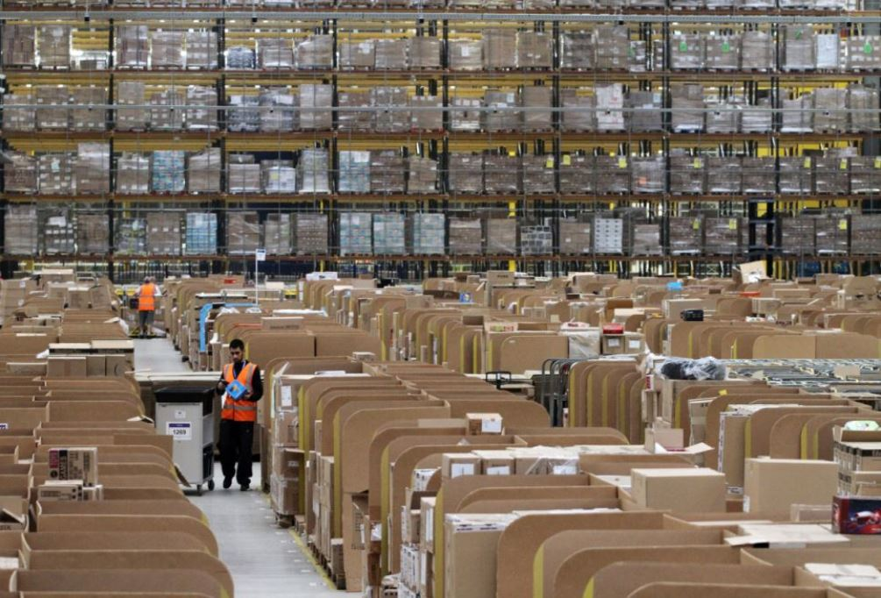

Discovery
Process Review
Receiving
Picking
Shipping
Cycle Counts
People
Training
New Processes or Roles
Technology Solution Options
Equipment & Infrastructure Costs
Project Costs
Value Capture (ROI)
Notes:
Next step in the discovery is to consider the people involved in the processes and the training efforts needed to implement:
Information to collect
How many employees will be involved
What type of training will be involved
Cost to train to include downtime

Slide 13
Training
XYZ and the vendor estimate that training the work force will take 8 hours to provide for the scanner process being considered. They will need to conduct training prior to the warehouse shifts in order to not disrupt daily business activities. Floor employee training will be done by the warehouse managers.
Estimated Cost for Training:
($3,000) – Vendor installation and warehouse manager training
($1,000) – Handout materials for floor employees
($4,089) - Overtime Pay for warehouse floor staff ( Back end staff can be trained during regular office hours)
_____________________________
Total: ($8,089)

Slide 14
Material Tagging
The way in which materials will be bar-coded depends on the methodology chosen:
Internally Tagged – The warehouse completes tagging of materials as they are received.
Vendor Printed Labels – A vendor is contracted to print the bar-codes directly on labels. More applicable for manufacturers.
Warehouse XYZ needs to tag incoming materials themselves, since none of their current suppliers bar-code their products.
Estimated cost for tagging materials:
($28,333) – One warehouse employee will need to perform this function for 70% of his/her time.
($5,000) – Annual cost of printing bar-codes for XYZ’s volume.
_____________________________
Total: ($33,333)
Note: This cost is mitigated for products that are already bar-coded from suppliers.

Slide 15
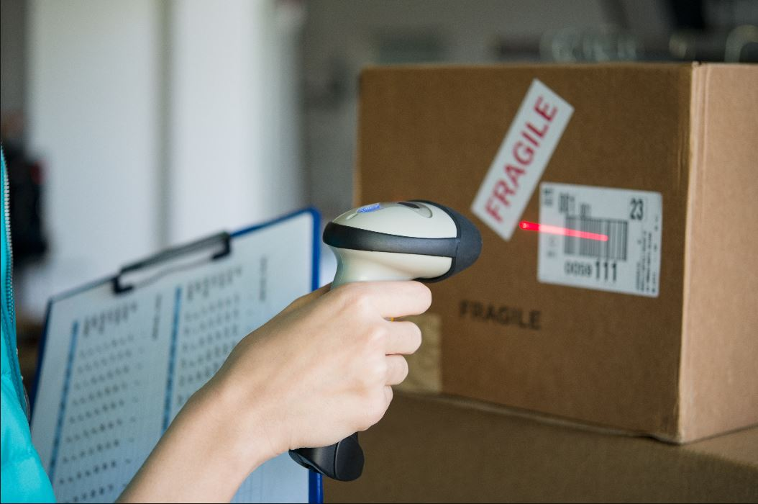
Discovery Phase
Process Review
Receiving
Picking
Shipping
Cycle Counts
People
Training
New Processes or Roles
Technology Solution Options
Equipment & Infrastructure
Project Cost
Value Capture (ROI)
Notes:
Now that you have reviewed your processes and people, you can begin to explore the options available today. If you have not engaged an outside resource prior to this step, you will need to now so you can make the right choices with equipment and understand cost

Slide 16
Equipment Investment
Warehouse XYZ decides to invest in average-priced equipment based on their need and desire of the functionality.
Price ranges can increase or decrease based on equipment quality and functionality
Decide what is needed for your own operation during this discovery phase.
Estimated Cost of Required Equipment:
($8,000) – Handheld Scanners X 10 @ $800 each
($17,204) – Mobile Computers X 6 @ $2,867.35 each
($350) – Docking Station x1 @ $350 each
($5,200) – Bar-Code Printers x2 @ $2,600 each
($5,500) – Wireless Access Points x10 @ $550 each
($360) – Server Software
($1000) – Shipping
_____________________________
Total: ($37,614)

Slide 17
Financing Options
There are multiple different ways to pay for much of the implementation cost.
Businesses can choose to pay for it up-front upon project initiation.
Another option is to be able finance the cost over time through monthly or annual payments.
This is similar to leasing, but leasing to own the equipment.
Allows the business to begin realizing return on their investment much more quickly versus having to absorb the full cost up-front.
Financing Over Time Example:
($37,614) – Total Required Equipment Investment Cost
5% – Financing Interest Rate
Term – 3 or 5 Years
_____________________________
Monthly Payments for 3 Years: ($1,127.33)
Monthly Payments for 5 Years: ($709.82)

Slide 18
Project Cost
Warehouse XYZ will hire a project manager to facilitate the implementation.
This resource can be internal or as contracted with a vendor.
The consultation with a bar-code vendor may also have cost associated.
In this example, there was a consulting fee.
Estimated Cost of Project Resources:
($6,000) – Project Manager for 60 hours @ $100 per hour
($1,500) – Consultation Fee
_____________________________
Total: ($7,500)

Slide 19

Capture Value
Process Review
Receiving
Picking
Shipping
Cycle Counts
People
Training
New Processes or Roles
Technology Solution Options
Equipment & Infrastructure Costs
Project Costs
Value Capture (ROI)

Slide 20
One-Time Implementation Cost
After the metrics, desired equipment, and process estimation is completed, XYZ’s warehouse manager and the bar-code vendor review the total cost.
Estimated Cost of the Implementation:
($8,089) – Training
($37,614) – Equipment Investment
($7,500) – Project Cost
_____________________________
Total: ($53,203)

Slide 21
WHY Implement?

Slide 22
Tangible vs Intangible Returns
Tangible Return can be measured and validated
Inventory Savings
Space Savings
Existing Labor Savings (minus) Additional Labor Costs
Order Fulfillment Revenue Previously Lost
Delivery Savings
Intangible Return is difficult to measure or validate but has value
Customer Satisfaction
Employee Satisfaction
Compliance
Is an industry, customer, and government requirement for doing business.
Risk Reduction

Slide 23
Scenario Tangible Benefits
Inputting the metrics gathered into the AgGateway AIDC Calculator, annual occurring benefits and costs are calculated for XYZ as follows:
Estimated Annual Benefits and Costs of the Implementation:
$21,938 – Labor Savings – Cost of labor processes manually (minus) cost of labor processes with AIDC technology.
($33,333) – Cost of Labor and Materials to Tag Inventory
$57,375 – Delivery Savings – Savings from preventing incorrect deliveries
$17,750 – Inventory Shrinkage Savings – Savings from preventing lost or stolen product cost
$90,000 – Order Fulfillment – Additional revenue from maintaining more accurate inventory counts to fulfill orders
($2,520) – Cost of Equipment Upkeep and Replacement
_____________________________
Total: $151,210

Slide 24
Delivery ROI Example
Estimated Cost Incurred From Incorrect Deliveries
Deliveries per year | 2500
Incorrect Delivery % | 3%
# of Deliveries | 75
Average Miles per Delivery | 300
Total Miles Driven | 22,500
Cost per Mile | $ 3.00
Total Cost | $ 67,500
Total Annual Savings with Bar Coding
Total Cost Incorrect Deliveries | $ 67,500.00
Estimated Reduction in # Incorrect Deliveries | 85%
Annual Savings | $ 57,375.00

Slide 25
ROI Modeling
There are multiple ways to model the implementation ROI:
Flat Rate Annual Returns
Does not account for changes year to year
Growth Rate Annual Returns (5%)
Accounts for material volume and order growth
Savings Realization Annual Returns (0%, 40%, 50% … 100%)
Accounts for minimizing initial financial benefits that the business receives at project inception due to the implementation taking place, but grows over time as the technology and processes become effectively adopted.
All Combined Models (Displayed Next)
Runs the flat rate model through all models

Slide 26
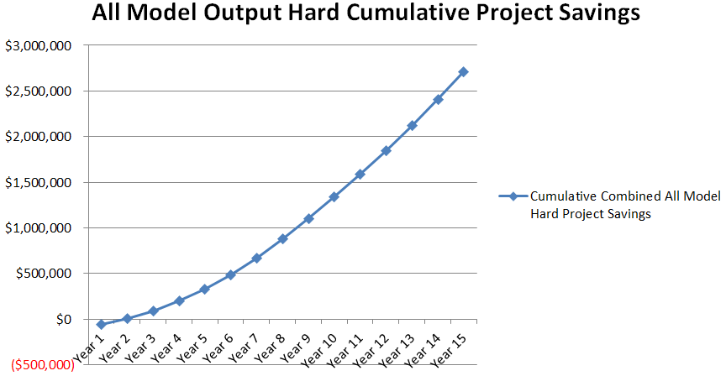
Total Implementation Tangible ROI

Slide 27
Intangible Benefits
For the purpose of this exercise, intangible benefits were not included because of the specificity tied to each business.
The AIDC Calculator is capable of estimating and summarizing some of these values if desired.
Regulatory infraction risk avoidance
Cost of product recall tracking
Customer satisfaction – retention, expectations, and supplier preference
More benefits are found from using bar-coding technology that are too difficult to calculate or too theoretical.
Extra cost incurred from a forced implementation
Better return facilitation with delivery carriers
More accurate inventory forecasting
Recall risk avoidance
Increased marketing agility – if information is shared across the supply chain
Implementation ROI often exponentially increases by including these estimates.

Slide 28
Industry Adoption and Future Vision
As more of the industry adopts bar-coding technology, even more benefits are delivered to those implemented.
Costs are diminished for downstream package handling.
Full product track-and-trace becomes available down to and for the end-user.
Inventory movement information becomes near real-time (Automate PMR and marketing data transmission and consumption).
Future projects are better enabled for implementation
Automated farm equipment can have products scanned and loaded into mechanical automation processes for product application or planting specifications.
Precision agriculture – farmers can scan products directly into their Farm Management Systems for error-free product data utilization

Slide 29
What is Needed from You?
IMPLEMENT!!
Or at least let us help you discover why you should implement.
Review your manual processes and metrics for performance without the technology
Process documentation for both manual and bar-code technology is also available through the AIDC Working Group.
Use the calculator to build the financial reasons why it makes sense for your business
Can be used to estimate across all locations in your business or..
Can be used on a location-by-location basis for more exact estimates
Can be manipulated to fit your specific business and implementation scale
Request your supply chain partners to also investigate!

Slide 30

Did you order the bar-codes?!
YOU CAN HANDLE THE TRUTH!!

Slide 31
Questions & Discussion

Slide 32
Thank you!

